Slide 1
OnLine Analytical Processing (OLAP) and MDB: BI Cubes
Kurt Friedrich
Spring 2020
Part 2

Slide 2
Following slides are from a book
WROX Knight’s Microsoft Business Intelligence 24-Hour Trainer

Slide 3
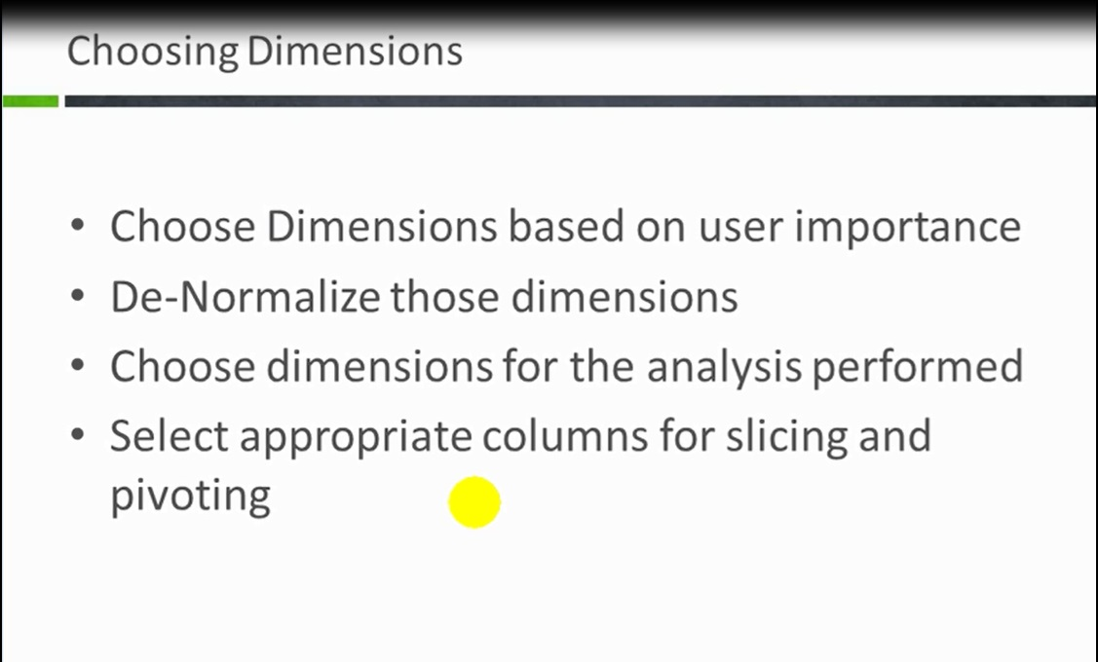

Slide 4
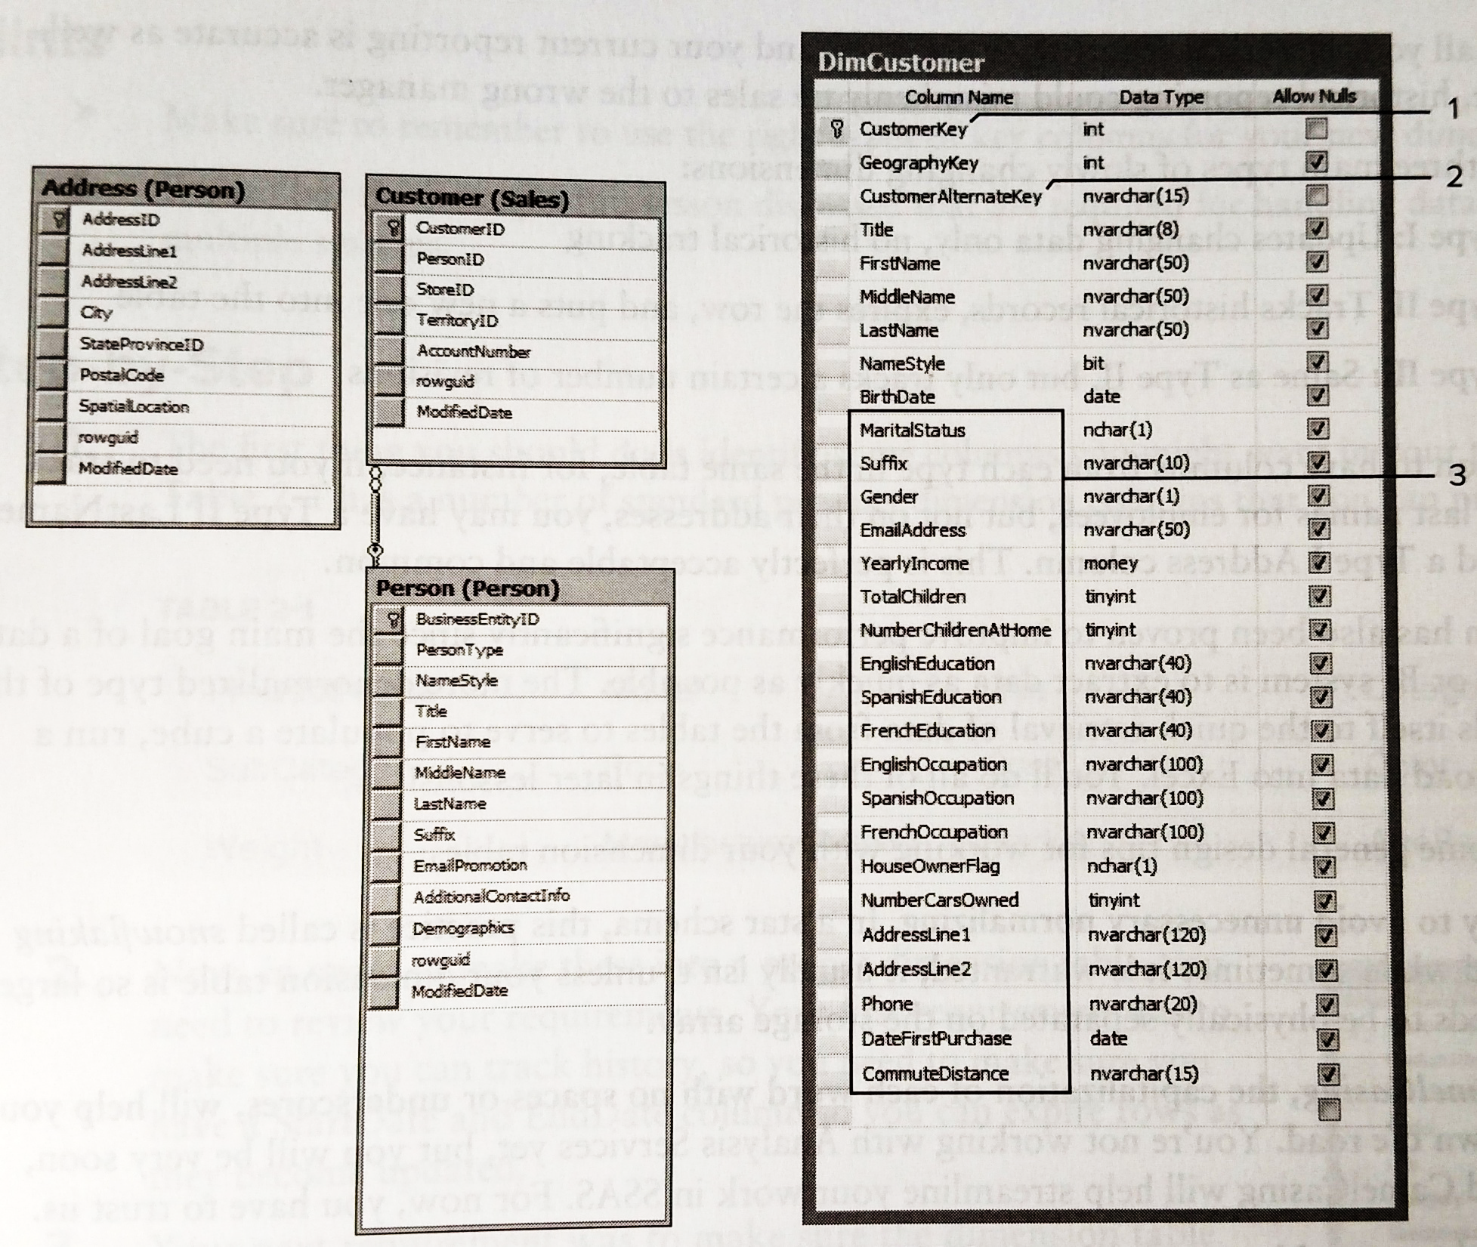
Denomralize
1-SurrogateKey
2-Old PriKey now alternate key(in case multi tables had same key value
3-Bring in any data that you need for your analysis

Slide 5
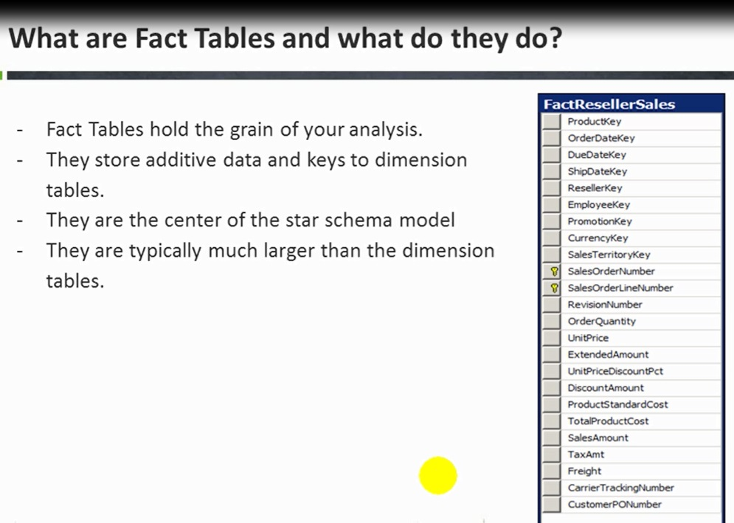

Slide 6
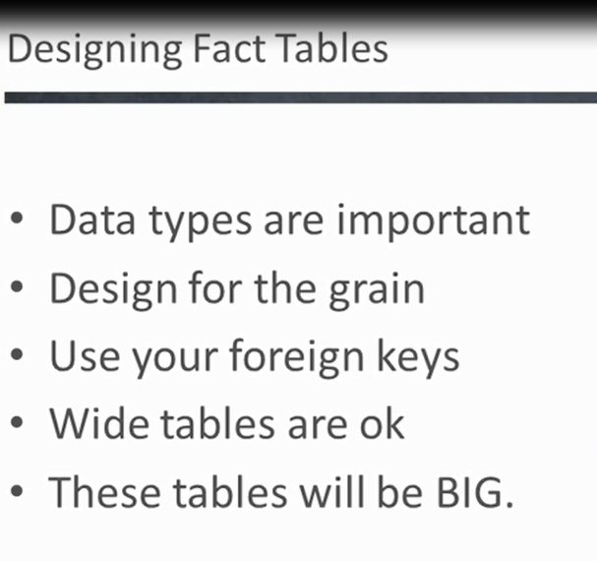
By state? By City?
Don’t mix 2 grains
One key for each dim you may want to use.

Slide 7
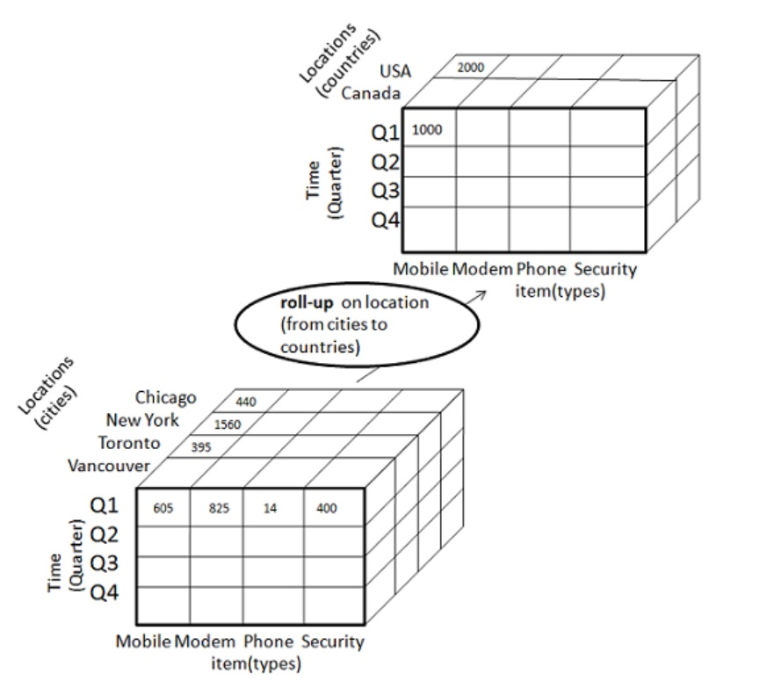

Slide 8
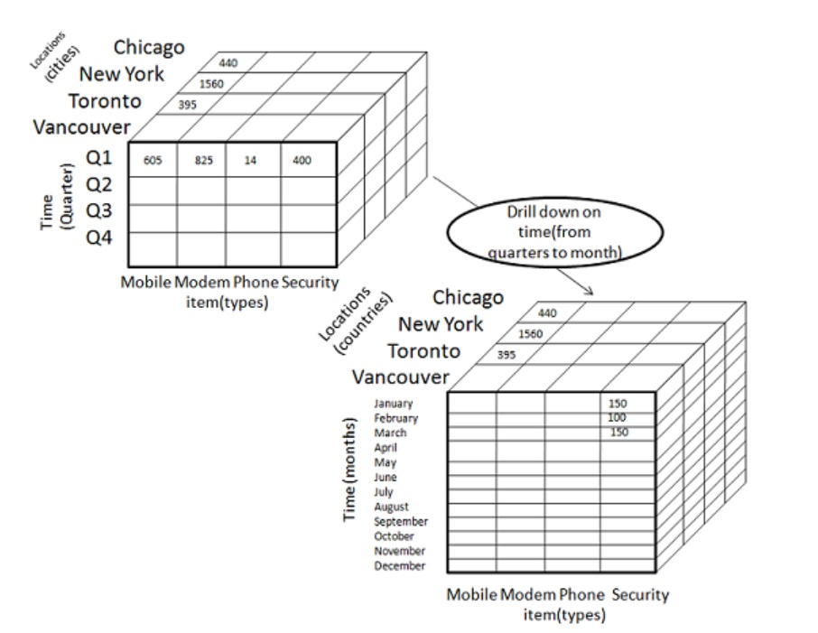

Slide 9
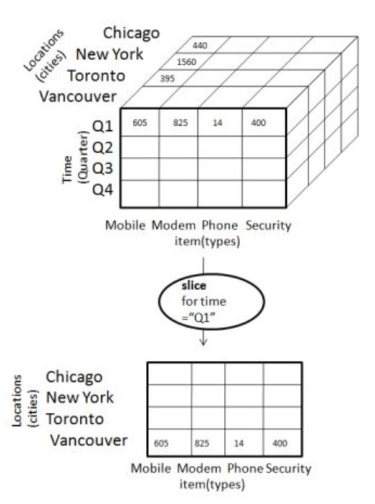

Slide 10
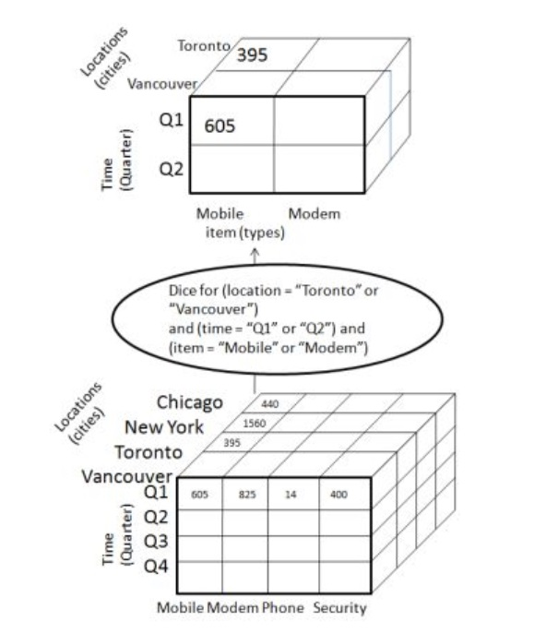

Slide 11
